Slide 1
Vue

Slide 2
Vue – Day 4

Slide 3
Agenda
Directives
v-on ( Event Handling )
v-if / v-else-if / v-else / v-show ( Conditional Rendering )
Component Events
Emitting and Listening to Events
Event Arguments
defineEmits
Computed Properties

Slide 4
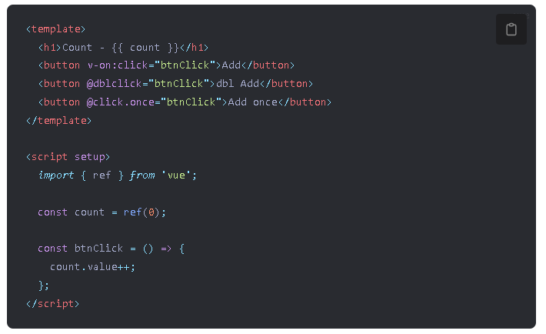
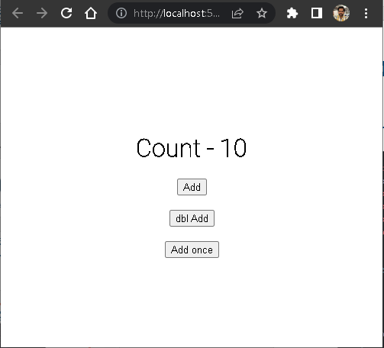
v-on
v-on is a directive in Vue.js that allows us to bind event listeners to DOM elements or Vue components.

Slide 5
v-on – Important Points
v-on is a directive that listens to a specified event and performs a given action when the event occurs.
The event that v-on listens for is specified by the argument of the directive, which can be a string literal or a JavaScript expression that evaluates to a string.
The action that v-on performs when the event occurs is specified by the value of the directive, which can be a method name, a JavaScript expression, or an object containing event handler functions.
v-on can be used with a shorthand syntax, where the event name is prefixed with @, e.g. @click="handleClick".
v-on can also be used with modifiers, which are special postfixes that specify extra behavior for the event listener, such as preventing default, stopping propagation, or capturing the event in the capture phase.

Slide 6
Event Modifiers
Modifiers are special postfixes denoted by a dot that can be added to an event listener in v-on.
Modifiers alter the default behavior of the event listener, such as preventing the default action, stopping the event from propagating further, or capturing the event in the capture phase.
Modifiers can be chained together to apply multiple behaviors to the event listener.
Some common modifiers in v-on include .prevent, .stop, .capture, .self, and .once.
The .prevent modifier prevents the default behavior of an element, such as submitting a form or following a link.
The .once modifier only triggers the event listener once, and then unbinds the event listener.

Slide 7
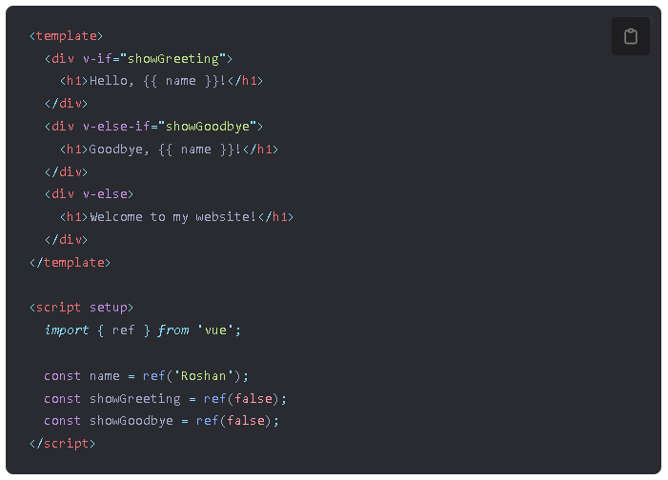
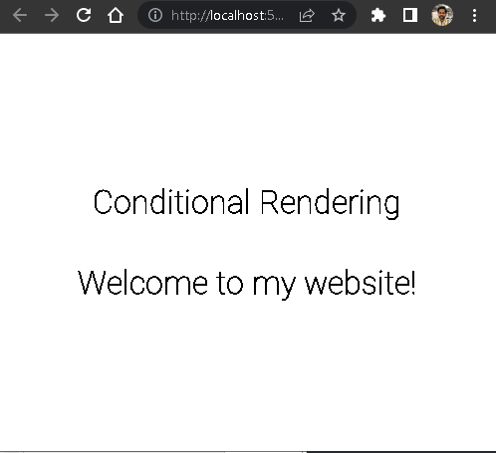
v-if, v-else, and v-else-if
v-if, v-else, and v-else-if are directives in Vue.js that are used for conditional rendering.

Slide 8
v-if, v-else, and v-else-if – Important Points
v-if is used to conditionally render a block of code. The block is only rendered if the condition in the directive is true. If the condition is false, the block is not rendered at all.
v-else is used in conjunction with v-if. It is used to render a block of code if the v-if condition is false. It must come immediately after the closing tag of the block of code for v-if.
v-else-if is also used in conjunction with v-if. It is used to add additional conditions to check if the v-if condition is false. It must come immediately after the closing tag of the block of code for v-if.

Slide 9
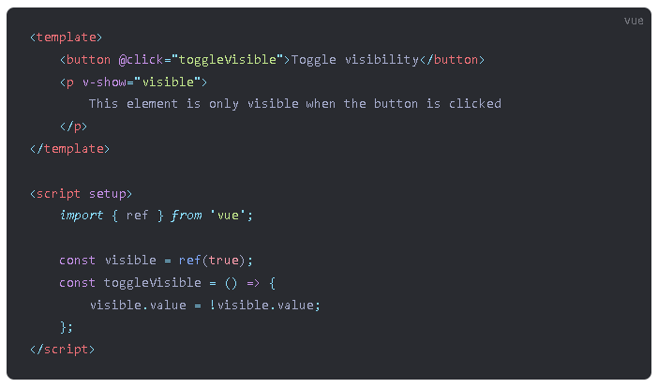
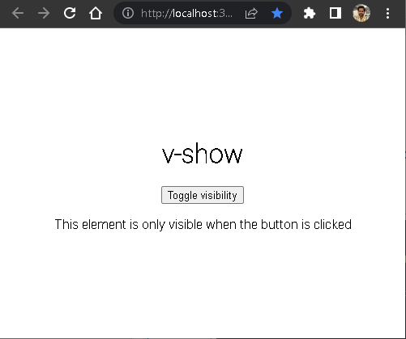
v-show
v-show is a directive in Vue.js that is used for conditional rendering. It's similar to v-if in that it can be used to show or hide elements based on a condition.

Slide 10
difference between v-show & v-if
v-if removes the element from the DOM if the condition is false, while v-show simply hides it.
Because v-if removes the element from the DOM, it can be more resource-intensive to use than v-show, especially if the element contains a large number of child components.
v-if is better suited for conditional rendering of large blocks of content or components, while v-show is better suited for toggling small pieces of content or components.
v-if has a higher priority than v-show, so if both directives are used on the same element, the element will only be rendered if the v-if condition is true.

Slide 11
Component events
Component events are a way for child components to communicate with parent components in Vue.js.
To emit an event from a child component, you use the $emit method and pass in the name of the event and any data you want to pass to the parent component.
In the parent component, you can listen for the emitted event using the v-on directive or the @ shorthand, and specify the name of the event and the method you want to call when the event is emitted.
When the child component emits the event, the parent component's method is called and any data that was passed along with the event is available in the method's arguments.

Slide 12

Emitting and Listening to Events
A component can emit custom events directly in template expressions (e.g. in a v-on handler) using the built-in $emit method:
The parent can then listen to it using v-on:

Slide 13
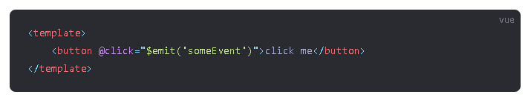
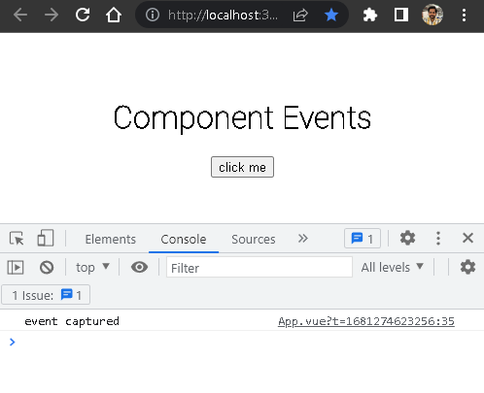
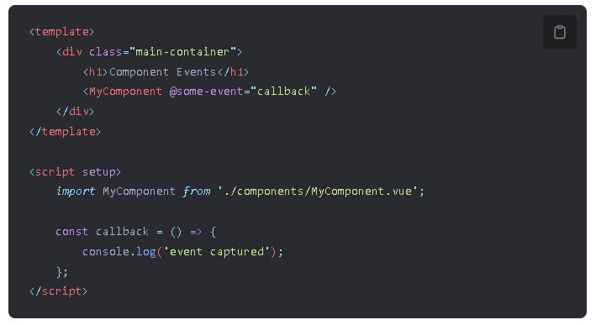
Emitting and Listening to Events

Slide 14
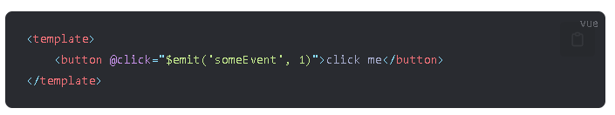
Event Arguments
Event arguments in Vue.js allow you to pass additional data along with an emitted event.
When you emit an event in Vue.js, you can include additional data as a second argument to the $emit function. This data can be anything that you want to pass along with the event, such as a string, number, object, or array.

Slide 15
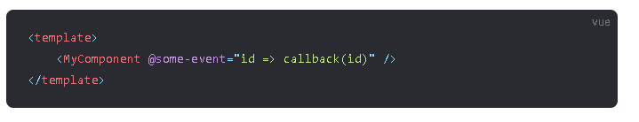
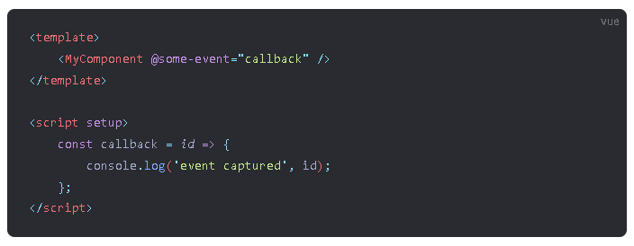
Event Arguments
In the parent component, you can listen for the emitted event and access the additional data using an inline arrow function as the listener, which allows us to access the event argument.
Or, if the event handler is a method, then the value will be passed as the first parameter of that method.

Slide 16
Declaring Emitted Events - defineEmits
A component can explicitly declare the events it will emit using the defineEmits() macro
The $emit method that is commonly used in the <template> section of a Vue.js component is not directly accessible within the <script setup> section. However, you can use the defineEmits() function to define the events that the component emits and it returns an equivalent function that can be used within the <script setup> section to emit events.

Slide 17
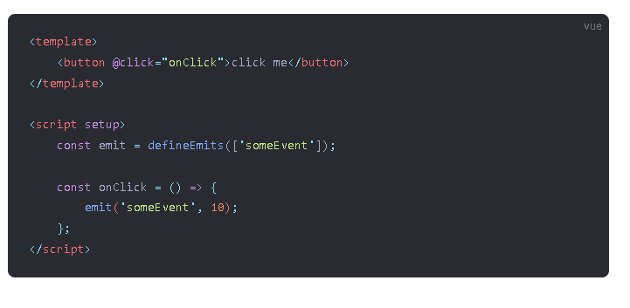
Declaring Emitted Events - defineEmits

Slide 18

Computed Properties

Slide 19
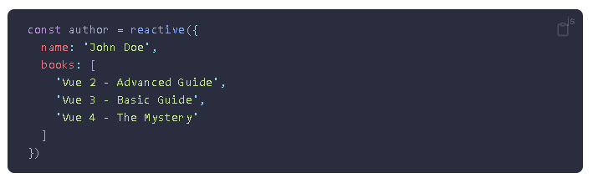
Computed Properties
In-template expressions are very convenient, but they are meant for simple operations. Putting too much logic in your templates can make them bloated and hard to maintain.
For example, if we have an object with a nested array:

Slide 20

Computed Properties
And we want to display different messages depending on if author already has some books or not.
At this point, the template is getting a bit cluttered. We have to look at it for a second before realizing that it performs a calculation depending on author.books. More importantly, we probably don't want to repeat ourselves if we need to include this calculation in the template more than once.

Slide 21
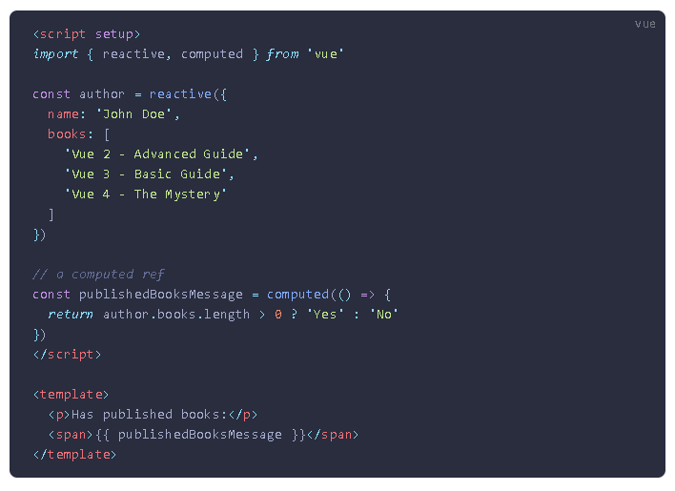
Computed Properties
That's why for complex logic that includes reactive data, it is recommended to use a computed property. Here's the same example, refactored:

Slide 22
Computed Properties
Here we have declared a computed property publishedBooksMessage. The computed() function expects to be passed a getter function, and the returned value is a computed ref. Similar to normal refs, you can access the computed result as publishedBooksMessage.value. Computed refs are also auto-unwrapped in templates so you can reference them without .value in template expressions.
A computed property automatically tracks its reactive dependencies. Vue is aware that the computation of publishedBooksMessage depends on author.books, so it will update any bindings that depend on publishedBooksMessage when author.books changes.

Slide 23
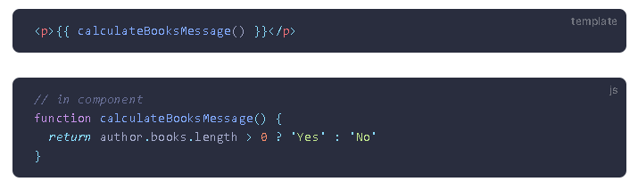
Computed Caching vs. Methods
You may have noticed we can achieve the same result by invoking a method in the expression.
Instead of a computed property, we can define the same function as a method. For the end result, the two approaches are indeed exactly the same. However, the difference is that computed properties are cached based on their reactive dependencies. A computed property will only re-evaluate when some of its reactive dependencies have changed. This means as long as author.books has not changed, multiple access to publishedBooksMessage will immediately return the previously computed result without having to run the getter function again.

Slide 24
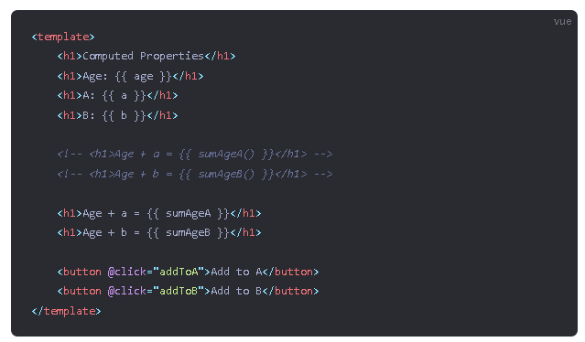

Slide 25
